Slide 1


David Hoff david.hoff@umb.edu – 617-480-9230
Institute for Community Inclusion
University of Massachusetts, Boston www.communityinclusion.org
Providing CBDS Services in the Current Environment

Slide 2


Panelists
James Sanon
Elder Soares
LaWan Swain

Slide 3
Handouts
CBDS During the Pandemic
Virtual Community Life Engagement
Participation of People with Disabilities in Online Groups and Activities
Resource List

Slide 4
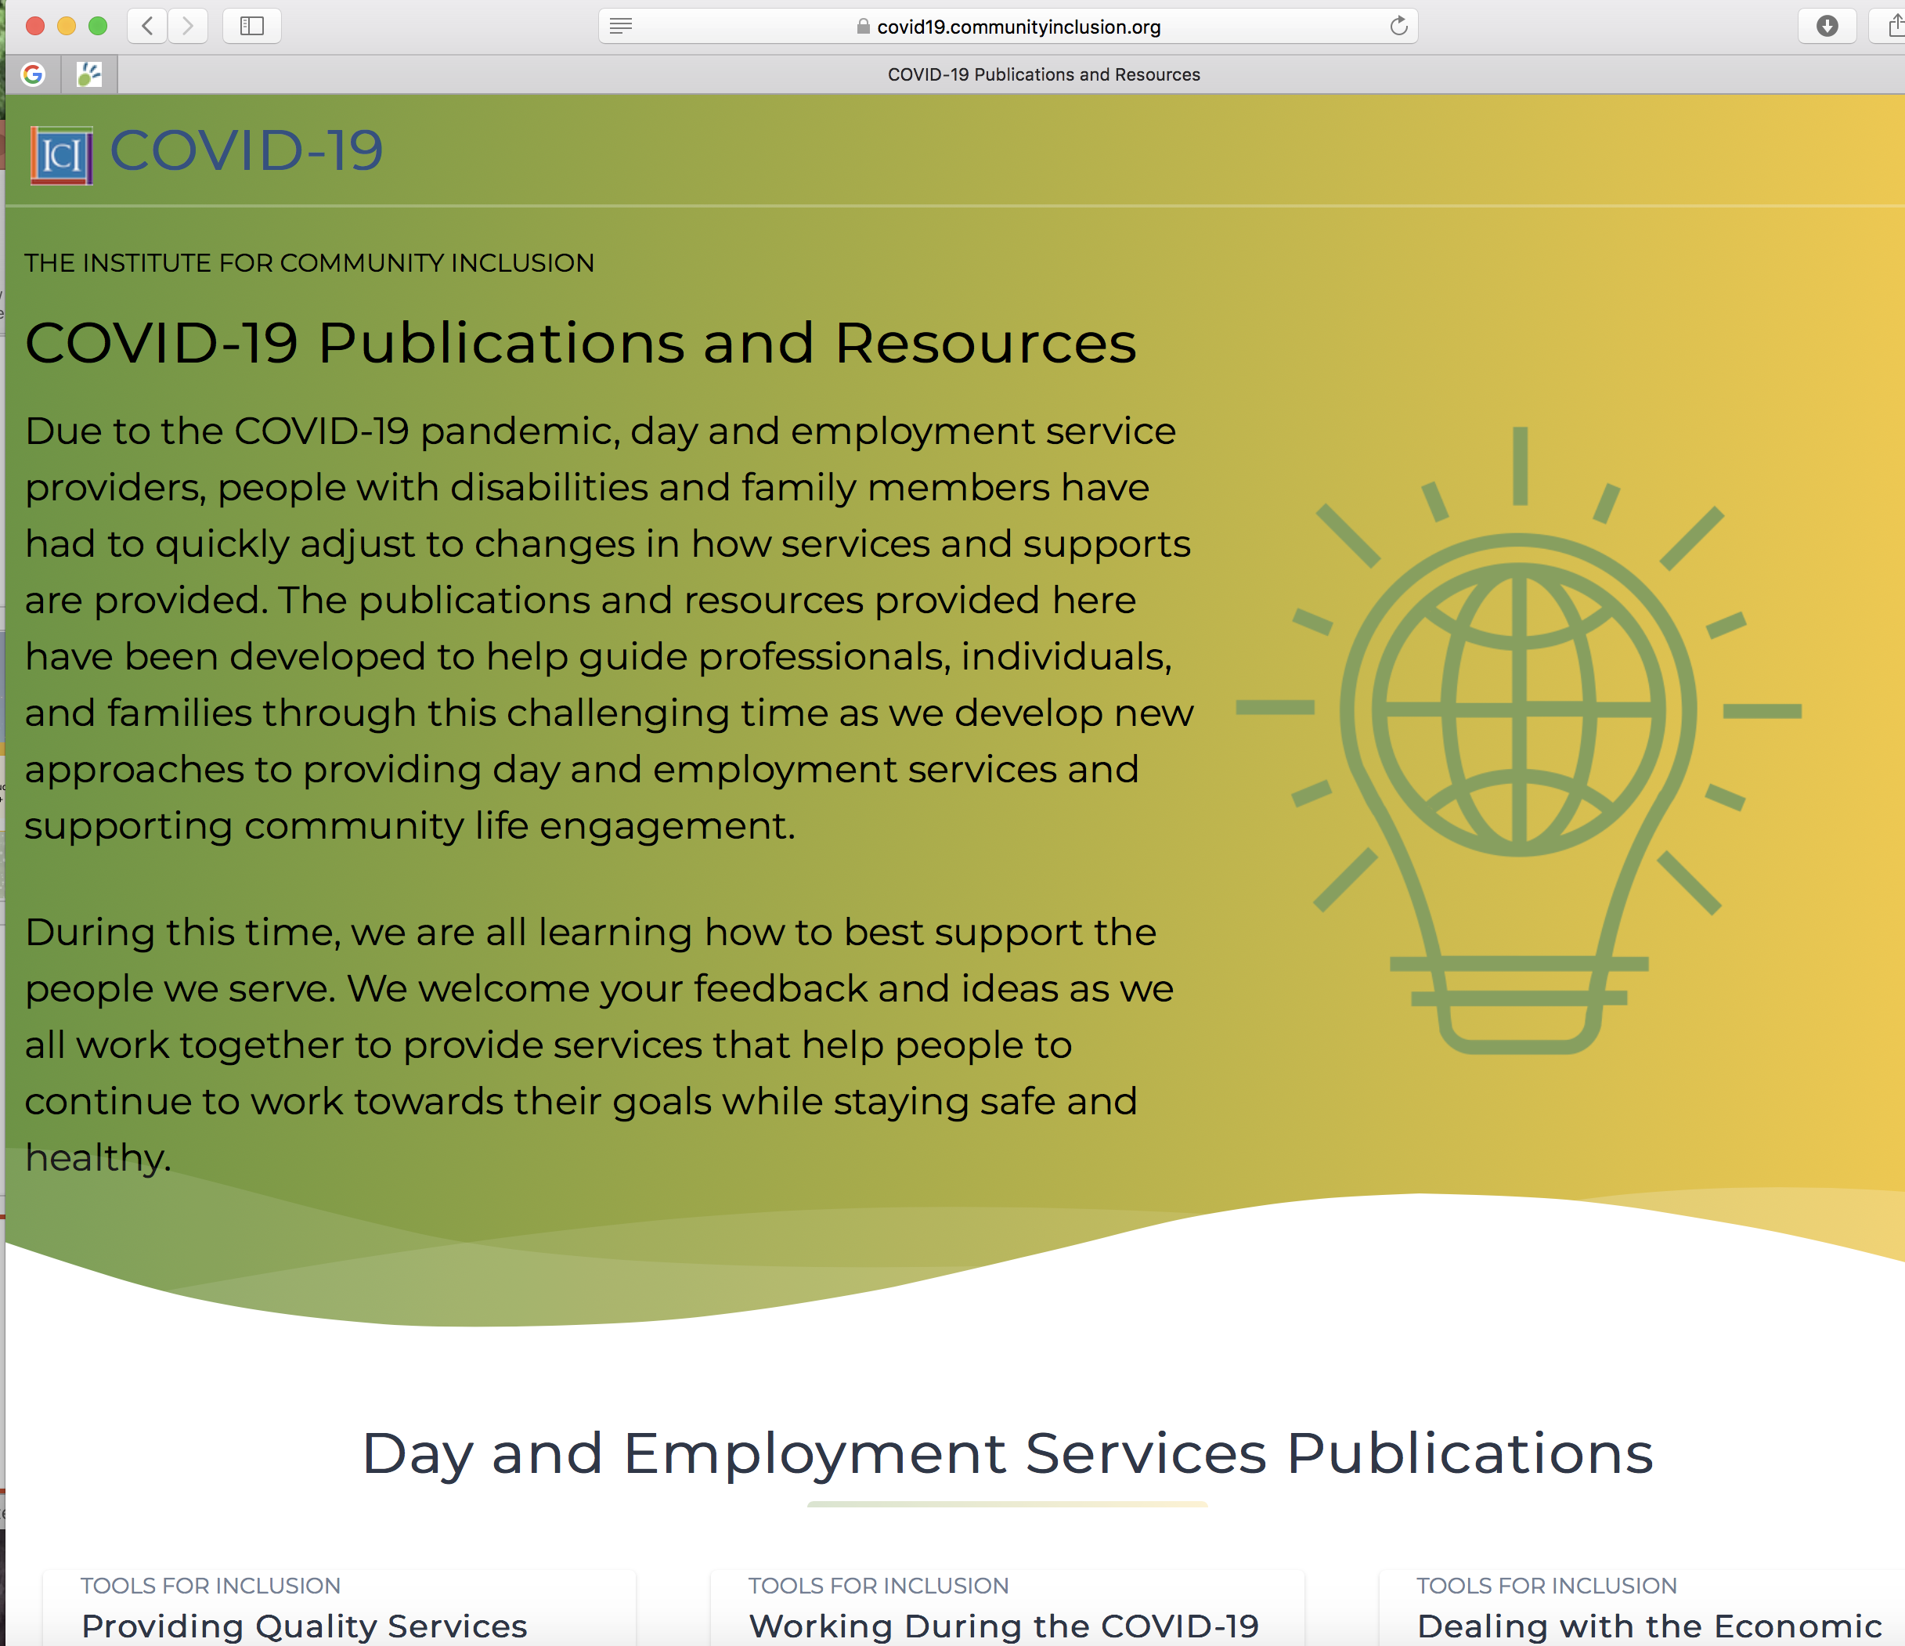
ICI COVID-19 Resource Page https://covid19.communityinclusion.org
25 publications
Resource listings

Slide 5

Time for a Poll
Your role

Slide 6
The Basics of
Community-Based
Day Supports

Slide 7

Who CBDS
Is For
For those currently working, providing wrap-around supports during non-work hours that enhance benefits of work or allow person to pursue a particular interest.
For those not working, supporting activities that promote a path to employment.
For those who are underemployed, supporting activities that promote a path to increased hours and wages.

Slide 8

Core Values of CBDS
Goal-oriented activities with a deliberate purpose
Flexible supports customized to individual needs
Engagement in a rich and diverse group of activities
Participation in activities with other community members in ways that are fully inclusive
Maximum participation in mainstream, non-disability specific activities

Slide 9
Poll
Current Status of CBDS

Slide 10

Individual
Service Provider
Community

Slide 11
Poll
Participation levels

Slide 12
Poll
Impact on settings
(2 questions)

Slide 13

Discussion
What types of CBDS activities are individuals participating in?
In what settings?

Slide 14

Continue previous activities in some form?
Options for new activities?

Slide 15


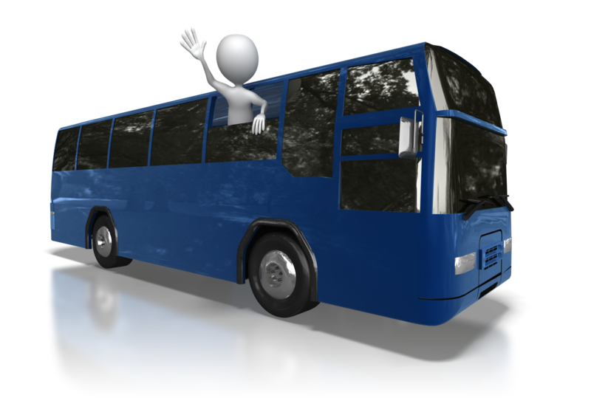

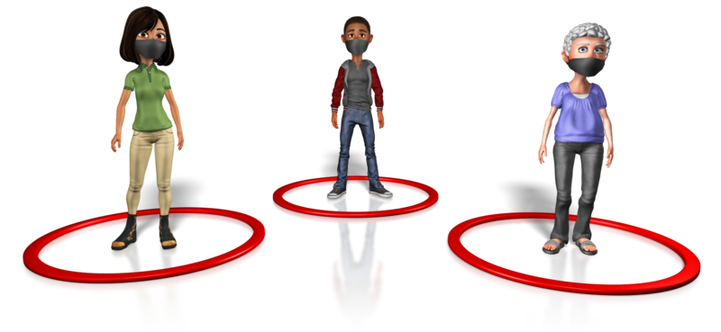



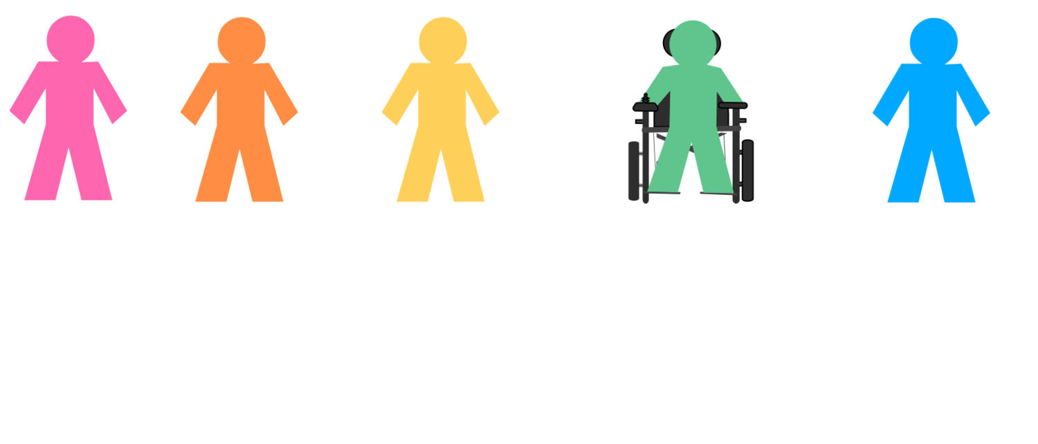

Possible activities
Soft & Hard Skill Development
Training on Technology
Travel Instruction
Community Exploration
Money Management
Pandemic Issues
Supporting Individuals Who Have Lost Jobs
Self-Advocacy
Career Exploration

Slide 16

Providing CBDS Services Remotely *
Technology availability
Capacity of individual
Necessary supports available at home
* Services provided where CBDS staff and individual are in two different locations

Slide 17

Home-Based Activities
What is appropriate for CBDS?
What is not appropriate for CBDS?

Slide 18

Online
Activities: Considerations
Technology availability and support
Focus on live activities
Local is preferred
Non-local activities may have their place
Avoid passive activities

Slide 19
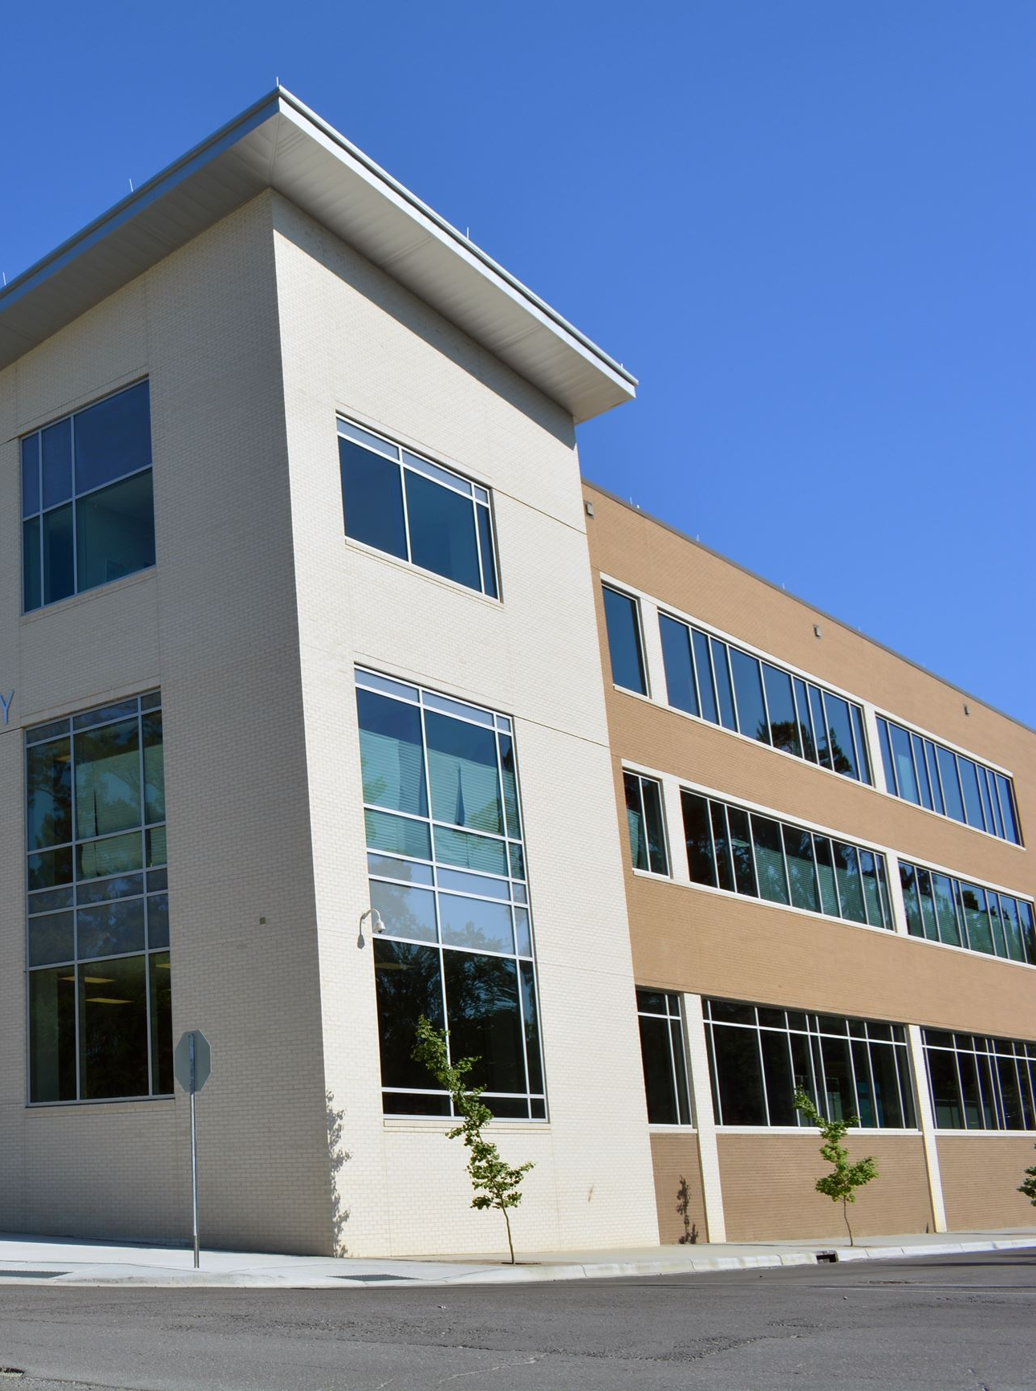
Using Your Building
Issues and considerations

Slide 20


Community Settings
Issues and considerations

Slide 21

Possible Models
Home & remote
Online
Agency building
Community
“Without Walls”
Hybrid

Slide 22

Looking to the
Future

Slide 23

“And once the storm is over, you won’t remember how you made it through,
how you managed to survive.
You won’t even be sure whether
the storm is really over.
But one thing is certain.
When you come out of the storm, you won’t be the same person who walked in.
That’s what this storm’s all about.”
Haruki Murakami

Slide 24


Slide 26




Slide 27



